Slide 1
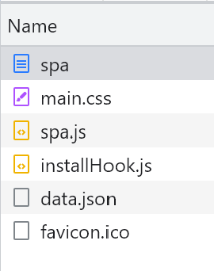
Browser
Server
GET https://studies.cs.Helsinki.fi/exampleapp/spa
HTML document
Status Code: 200
GET https://studies.cs.Helsinki.fi/exampleapp/main.css
The style sheet
Status Code: 200
GET https://studies.cs.Helsinki.fi/exampleapp/spa.js
The browser executes the callback function that renders the notes.
Status Code: 200
The JavaScript file
The code fetches the notes from the server as JSON data.
GET https://studies.cs.Helsinki.fi/exampleapp/data.json
The code adds HTML elements for displaying the notes to the page using the DOM-API.
JSON data
Status Code: 200
{“content”: “note 1”, “date”: “2023-4-21”}, {“content”: “note 2”, “date”: “2023-4-23”}, …
https://studies.cs.helsinki.fi/favicon.ico
Favicon [Image]
Status Code: 200

